Slide 1

Application project
Karwan University
Faculty of Computer Science
Lecture 1: Course Overview
Lecturer: Ahmad Javid Mayar

Slide 2

Contents:
Class Policies and Organizational Issues
Course Information
Organizational Issues
Course Contents
Literature
Introduction to Topic
Overview of Java Basics
Overview of Java Object Oriented Concepts

Slide 3
Course Information
Course Name:
Application Project
Pre-Requirements for the participation
Introduction to Java Programming and Advanced Techniques in Programming.
Type of Course:
Short Lecture with Practical Work and Project.
Slides and Extra Notes:
All course materials will be shared in GitHub.

Slide 4
Lecture Issues
Office hours
Sunday 06:00 am – 06:00 pm
Thursday 06:00 am – 06:00 pm
Private appointment
Contact me through email.
ahmadjavid.20418@gmail.com

Slide 5
Assignments
weekly basis
Rules • The Assignments should be handover Before the deadline... • You will work on the homework will be individual. • There should be no copy and paste • The copy and paste homework has zero points • Don’t Cheat Yourself, Please!!!...

Slide 6
Projects
Determine your partners for Projects(Maximum three members).
Select a topic for your project.
Create a scenario.
Select a software engineering model.
Requirements, Design and Implementation.
Final Documentation and Presentation.

Slide 7
Examination and Grading
Exams
Mid-term Exam: 20% ( 10% homework, 10% presentation
Final-term Exam: 80% ( 40% project , 40% final test )
Others
Class Activity and homework is the important part of this course.

Slide 8
Class Rules
Full attendance
Please come on time
Turn off your mobile.
Don’t disturb your classmate !!!!

Slide 9
Problems and Question
Place:
Computer Science Faculty(Lecturer room)
Internet contact :
mayar.ku.cs@gmail.com

Slide 10
Course Contents
Overview of Java Basics and OOP
Project Startup(Scenario, Use case Diagram, Git).
GUI(JavaFx).
Event Handling.
Exception Handling.
ER Diagram and Sql Server.
Database Connection.
I/O file Handling.
Multithreading.
Network Programming.
Remote Method Invocation (RMI).

Slide 11
Literature
Dietel, P., Deitel, H.; Java How to Program, 9th ed., 2011.
Tymann, P. T., Schneider, G. M.; Modern Software Development Using Java, 2007.
Culwin, F.; Java GUI Programmersʼ Primer A.
Oaks, S., Wong, H.; Java Threads, OʼReilly, 2004.
Ivan Marsic, Software Engineering 2012 – Rutgers

Slide 12
Contents:
Introduction to Java
Control Statements

Slide 13
Introduction to Java

Slide 14
What is Java
Java is a programming language and a platform.
Java is a high level, robust, secured and object-oriented programming language.
Platform: Any hardware or software environment in which a program runs, is known as a platform. Since Java has its own runtime environment (JRE) and API, it is called platform.
Java Example:
class Simple{
public static void main(String args[]){
System.out.println("Hello Java");
}
}

Slide 15
Where it is used?
According to Sun, 3 billion devices run java. There are many devices where java is currently used. Some of them are as follows:
Desktop Applications such as acrobat reader, media player, antivirus etc.
Web Applications such as irctc.co.in.
Enterprise Applications such as banking applications.
Mobile
Embedded System
Smart Card
Robotics
Games etc.

Slide 16
Types of Java Applications
There are mainly 4 type of applications that can be created using java programming:
1) Standalone Application
It is also known as desktop application or window-based application. An application that we need to install on every machine such as media player, antivirus etc. AWT and Swing are used in java for creating standalone applications.
2) Web Application
An application that runs on the server side and creates dynamic page, is called web application. Currently, servlet, jsp, struts, jsf etc. technologies are used for creating web applications in java.
3) Enterprise Application
An application that is distributed in nature, such as banking applications etc. It has the advantage of high level security, load balancing and clustering. In java, EJB is used for creating enterprise applications.
4) Mobile Application
An application that is created for mobile devices. Currently Android and Java ME are used for creating mobile applications.

Slide 17
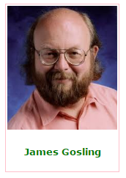
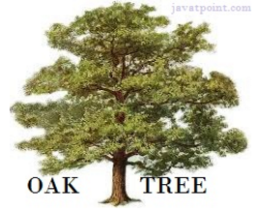
History of Java
James Gosling, Mike Sheridan, and Patrick Naughton initiated the Java language project in June 1991. The small team of sun engineers called Green Team.
Originally designed for small, embedded systems in electronic appliances like set-top boxes.
Firstly, it was called "Greentalk" by James Gosling and file extension was .gt.
After that, it was called Oak and was developed as a part of the Green project.
In 1995, Oak was renamed as "Java" because it was already a trademark by Oak Technologies.
Java is an island of Indonesia where first coffee was produced (called java coffee).

Slide 18
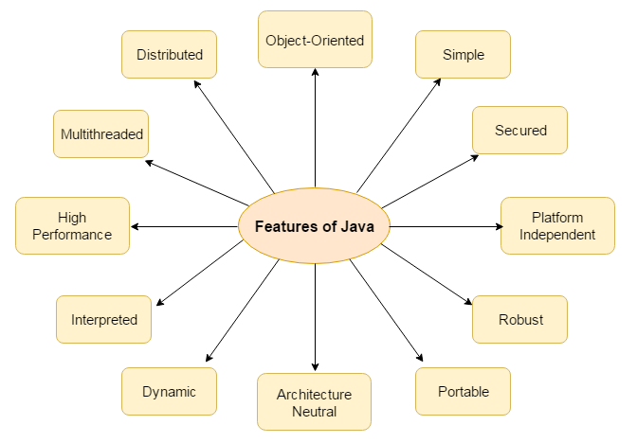
Features of Java

Slide 19
Features of Java
Simple:
According to Sun, Java language is simple because:
syntax is based on C++ (so easier for programmers to learn it after C++).
removed many confusing and/or rarely-used features e.g., explicit pointers, operator overloading etc.
No need to remove unreferenced objects because there is Automatic Garbage Collection in java.
Object-oriented
Object-oriented programming(OOPs) is a methodology that simplify software development and maintenance by providing some rules.
Basic concepts of OOPs are:
Object, Class, Inheritance, Polymorphism, Abstraction, Encapsulation

Slide 20
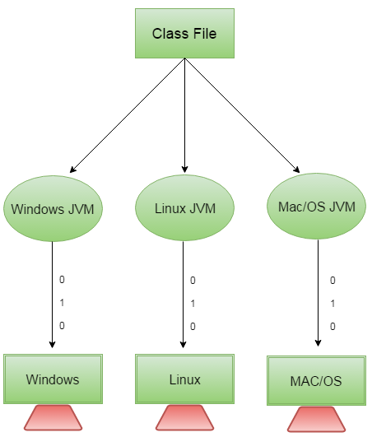
Features of Java
Platform Independent
The Java platform differs from most other platforms in the sense that it is a software-based platform that runs on the top of other hardware-based platforms. It has two components:
Runtime Environment
API(Application Programming Interface)

Slide 21
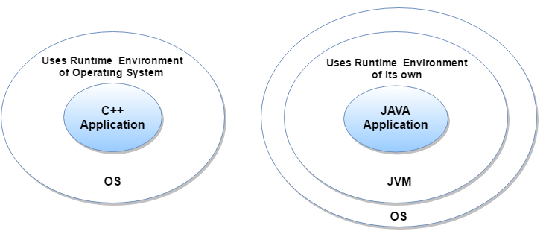
Features of Java
Secured
Java is secured because:
No explicit pointer
Java Programs run inside virtual machine sandbox

Slide 22
Features of Java
Robust
Robust simply means strong. Java uses strong memory management. There are lack of pointers that avoids security problem. There is automatic garbage collection in java. There is exception handling and type checking mechanism in java. All these points makes java robust.
Architecture-neutral
There is no implementation dependent features e.g. size of primitive types is fixed.
In C programming, int data type occupies 2 bytes of memory for 32-bit architecture and 4 bytes of memory for 64-bit architecture. But in java, it occupies 4 bytes of memory for both 32 and 64 bit architectures.

Slide 23
Features of Java
Portable
We may carry the java bytecode to any platform
High-performance
Java is faster than traditional interpretation since byte code is "close" to native code still somewhat slower than a compiled language (e.g., C++)
Distributed
We can create distributed applications in java. RMI and EJB are used for creating distributed applications. We may access files by calling the methods from any machine on the internet.

Slide 24
Features of Java
Multi-threaded
A thread is like a separate program, executing concurrently.
We can write Java programs that deal with many tasks at once by defining multiple threads.
The main advantage of multi-threading is that it doesn't occupy memory for each thread. It shares a common memory area.
Threads are important for multi-media, Web applications etc.

Slide 25
Simple Program of Java
Requirement for your first program:
install the JDK if you don't have installed it, download the JDK and install it.
set path of the jdk/bin directory.
create the java program
compile and run the java program
class Simple{
public static void main(String args[]){
System.out.println("Hello Java");
}
}

Slide 26
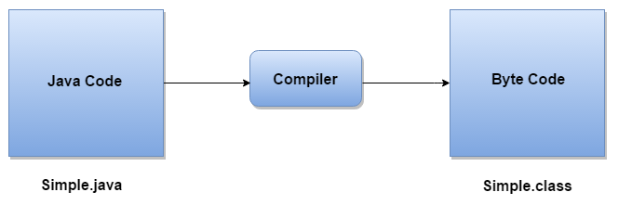
What happens at compile time?
At compile time, java file is compiled by Java Compiler (It does not interact with OS) and converts the java code into bytecode.

Slide 27
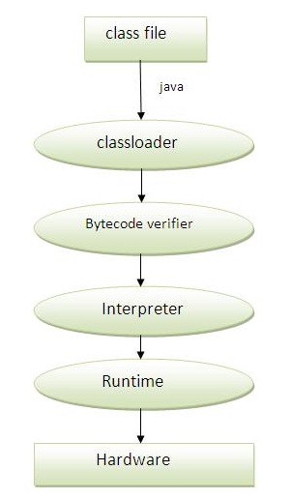
What happens at runtime?
At runtime, various steps are performed as shown in the figure.
Classloader: is the subsystem of JVM that is used to load class files.
Bytecode Verifier: checks the code fragments for illegal code that can violate access right to objects.
Interpreter: read bytecode stream then execute the instructions

Slide 28
Difference between JDK, JRE and JVM
JVM
JVM (Java Virtual Machine) is an abstract machine. It is a specification that provides runtime environment in which java bytecode can be executed.
JVMs are available for many hardware and software platforms. JVM, JRE and JDK are platform dependent because configuration of each OS differs. But, Java is platform independent.
The JVM performs following main tasks:
Loads code
Verifies code
Executes code
Provides runtime environment

Slide 29
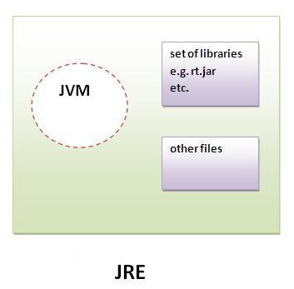
Difference between JDK, JRE and JVM
JRE
JRE is an acronym for Java Runtime Environment.
It is used to provide runtime environment.
It is the implementation of JVM.
It physically exists.
It contains set of libraries + other files that JVM uses at runtime.

Slide 30
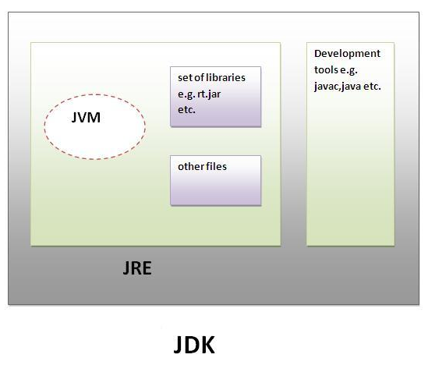
Difference between JDK, JRE and JVM
JDK
JDK is an acronym for Java Development Kit.
It physically exists.
It contains JRE + development tools.

Slide 31
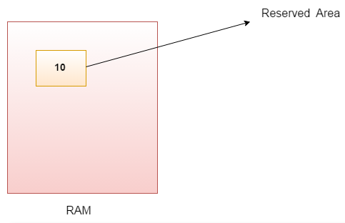
Variables and Data Types in Java
Variable is a name of memory location. There are three types of variables in java: local, instance and static.
There are two types of data types in java: primitive and non-primitive.
Variable is name of reserved area allocated in memory. In other words, it is a name of memory location. It is a combination of "vary + able" that means its value can be changed.

Slide 32
Types of Variable
There are three types of variables in java:
local variable
A variable which is declared inside the method is called local variable.
instance variable
A variable which is declared inside the class but outside the method, is called instance variable . It is not declared as static.
static variable
A variable that is declared as static is called static variable. It cannot be local.

Slide 33
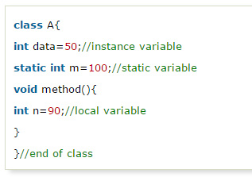
Example to understand the types of variables in java

Slide 34
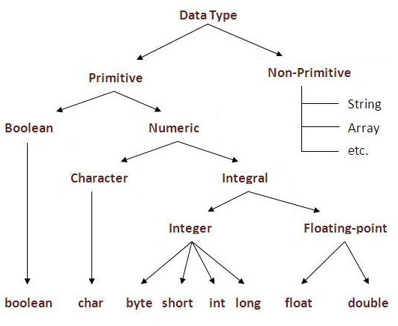
Data Types in Java
Data types represent the different values to be stored in the variable. In java, there are two types of data types:
Primitive data types
Non-primitive data types

Slide 35
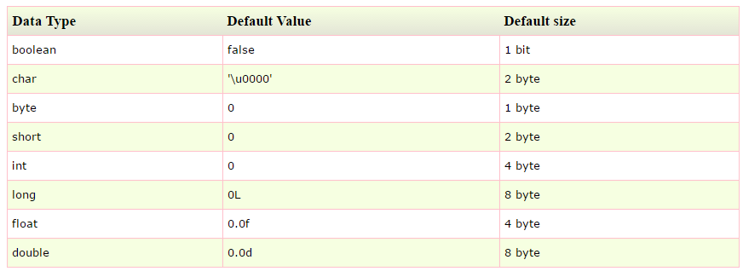
Data Types in Java

Slide 36
Operators in java
Operator in java is a symbol that is used to perform operations. For example: +, -, *, / etc.
There are many types of operators in java which are given below:
Unary Operator,
Arithmetic Operator,
shift Operator,
Relational Operator,
Bitwise Operator,
Logical Operator,
Ternary Operator and
Assignment Operator.

Slide 37
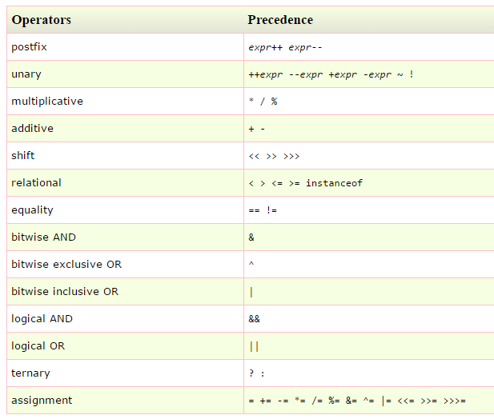

Slide 38
Control Statements

Slide 39
Java If-else Statement
The Java if statement is used to test the condition. It checks boolean condition: true or false.
There are various types of if statement in java.
if statement
if-else statement
nested if statement
if-else-if ladder

Slide 40
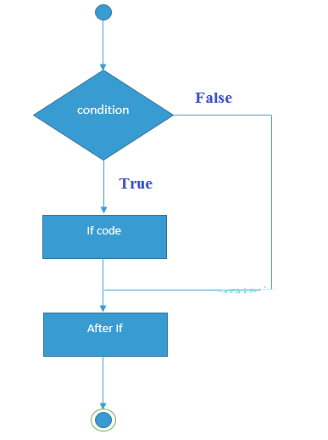
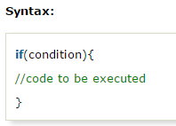
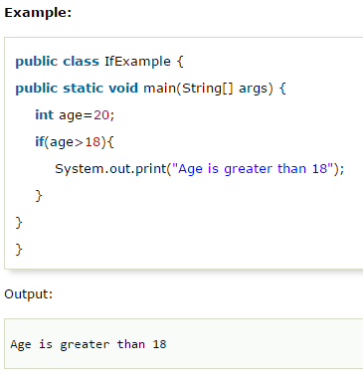
Java IF Statement
The Java if statement tests the condition. It executes the if block if condition is true.

Slide 41
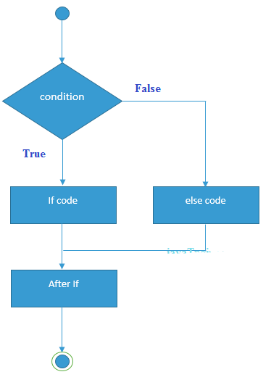
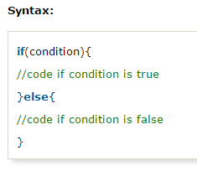
Java IF-else Statement
The Java if-else statement also tests the condition. It executes the if block if condition is true otherwise else block is executed.

Slide 42
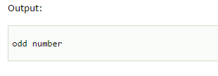
Example:
public class IfElseExample {
public static void main(String[] args) {
int number=13;
if(number%2==0){
System.out.println("even number");
}else{
System.out.println("odd number");
}
}
}

Slide 43
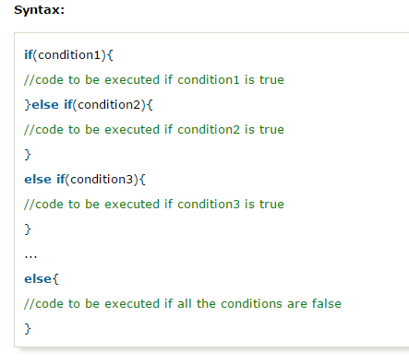
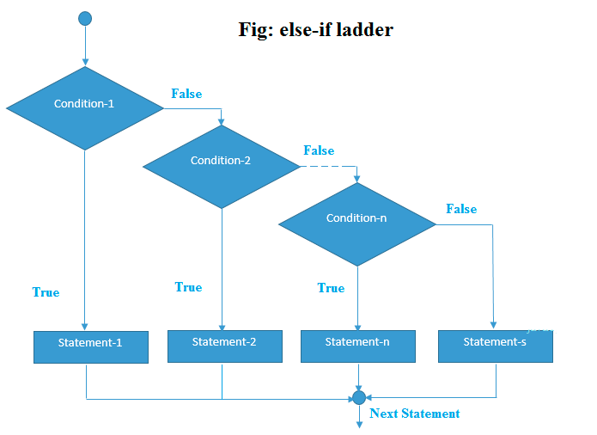
Java IF-else-if ladder Statement
The if-else-if ladder statement executes one condition from multiple statements.

Slide 44

Example:
public class IfElseIfExample {
public static void main(String[] args) {
int marks=65;
if(marks<50){
System.out.println("fail");
}
else if(marks>=50 && marks<60){
System.out.println("D grade");
}
else if(marks>=60 && marks<70){
System.out.println("C grade");
}
else if(marks>=70 && marks<80){
System.out.println("B grade");
}
else if(marks>=80 && marks<90){
System.out.println("A grade");
}else if(marks>=90 && marks<100){
System.out.println("A+ grade");
}else{
System.out.println("Invalid!");
}
}
}

Slide 45
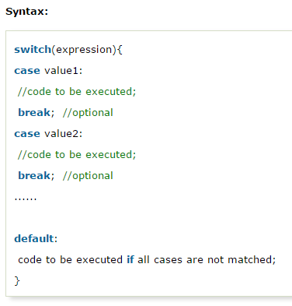
Java Switch Statement
The Java switch statement executes one statement from multiple conditions.
It is like if-else-if ladder statement.

Slide 46
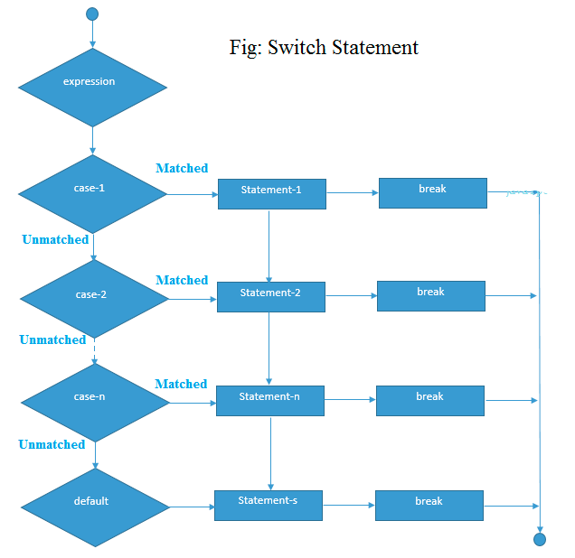

Slide 47

Example:
public class SwitchExample {
public static void main(String[] args) {
int number=20;
switch(number){
case 10: System.out.println("10");break;
case 20: System.out.println("20");break;
case 30: System.out.println("30");break;
default:System.out.println("Not in 10, 20 or 30");
}
}
}

Slide 48
Java For Loop
The Java for loop is used to iterate a part of the program several times. If the number of iteration is fixed, it is recommended to use for loop.
There are three types of for loop in java.
Simple For Loop
For-each or Enhanced For Loop
Labeled For Loop

Slide 49
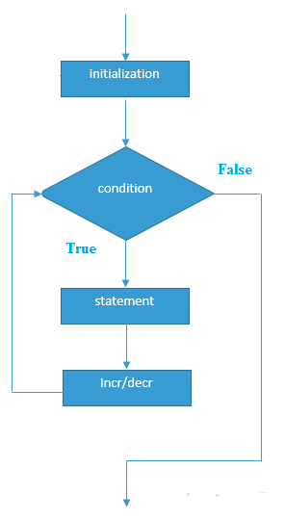
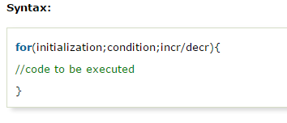
Java Simple For Loop
The simple for loop is same as C/C++.
We can initialize variable, check condition and increment or decrement value.

Slide 50
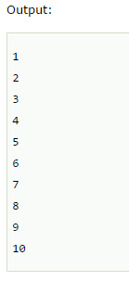
Example
public class ForExample {
public static void main(String[] args) {
for(int i=1;i<=10;i++){
System.out.println(i);
}
}
}

Slide 51
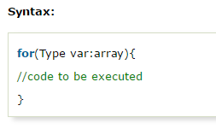
Java For-each Loop
The for-each loop is used to traverse array or collection in java. It is easier to use than simple for loop because we don't need to increment value and use subscript notation.
It works on elements basis not index. It returns element one by one in the defined variable.

Slide 52
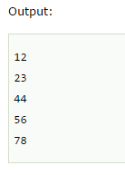
Example
public class ForEachExample {
public static void main(String[] args) {
int arr[]={12,23,44,56,78};
for(int i:arr){
System.out.println(i);
}
}
}

Slide 53
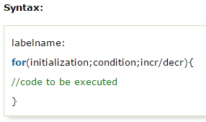
Java Labeled For Loop
We can have name of each for loop. To do so, we use label before the for loop. It is useful if we have nested for loop so that we can break/continue specific for loop.
Normally, break and continue keywords breaks/continues the inner most for loop only.

Slide 54
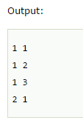
Example
public class LabeledForExample {
public static void main(String[] args) {
aa:
for(int i=1;i<=3;i++){
bb:
for(int j=1;j<=3;j++){
if(i==2&&j==2){
break aa;
}
System.out.println(i+" "+j);
}
}
}
}

Slide 55
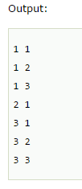
If you use break bb;, it will break inner loop only which is the default behavior of any loop.
public class LabeledForExample {
public static void main(String[] args) {
aa:
for(int i=1;i<=3;i++){
bb:
for(int j=1;j<=3;j++){
if(i==2&&j==2){
break bb;
}
System.out.println(i+" "+j);
}
}
}
}

Slide 56
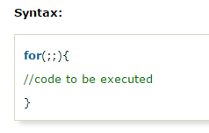
Java Infinitive For Loop
If you use two semicolons ;; in the for loop, it will be infinitive for loop.

Slide 57
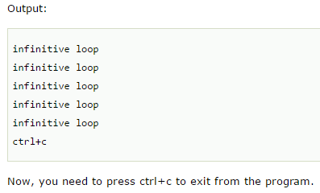
Example
public class ForExample {
public static void main(String[] args) {
for(;;){
System.out.println("infinitive loop");
}
}
}

Slide 58
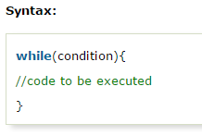
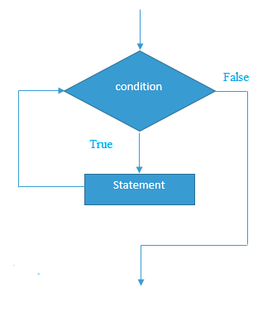
Java While Loop
The Java while loop is used to iterate a part of the program several times. If the number of iteration is not fixed, it is recommended to use while loop.

Slide 59
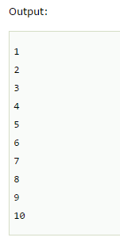
Example
public class WhileExample {
public static void main(String[] args) {
int i=1;
while(i<=10){
System.out.println(i);
i++;
}
}
}

Slide 60
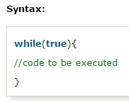
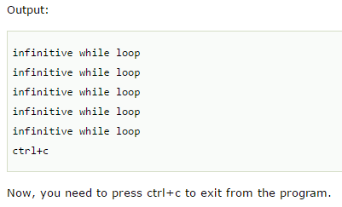
Java Infinitive While Loop
If you pass true in the while loop, it will be infinitive while loop.
public class WhileExample2 {
public static void main(String[] args) {
while(true){
System.out.println("infinitive while loop");
}
}
}

Slide 61
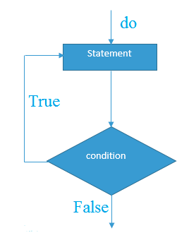
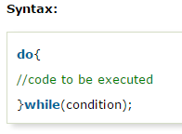
Java do-while Loop
The Java do-while loop is used to iterate a part of the program several times. If the number of iteration is not fixed and you must have to execute the loop at least once, it is recommended to use do-while loop.
The Java do-while loop is executed
at least once because
condition is checked after loop body.

Slide 62
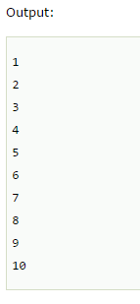
Example:
public class DoWhileExample {
public static void main(String[] args) {
int i=1;
do{
System.out.println(i);
i++;
}while(i<=10);
}
}

Slide 63
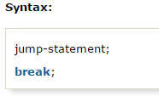
Java Break Statement
The Java break is used to break loop or switch statement.
It breaks the current flow of the program at specified condition. In case of inner loop, it breaks only inner loop.

Slide 64

Java Break Statement with Loop
public class BreakExample {
public static void main(String[] args) {
for(int i=1;i<=10;i++){
if(i==5){
break;
}
System.out.println(i);
}
}
}

Slide 65

Java Break Statement with Inner Loop
It breaks inner loop only if you use break statement inside the inner loop.
public class BreakExample2 {
public static void main(String[] args) {
for(int i=1;i<=3;i++){
for(int j=1;j<=3;j++){
if(i==2&&j==2){
break;
}
System.out.println(i+" "+j);
}
}
}
}

Slide 66
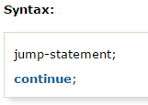
Java Continue Statement
The Java continue statement is used to continue loop. It continues the current flow of the program and skips the remaining code at specified condition. In case of inner loop, it continues only inner loop.

Slide 67
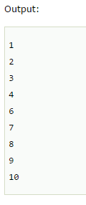
Example
public class ContinueExample {
public static void main(String[] args) {
for(int i=1;i<=10;i++){
if(i==5){
continue;
}
System.out.println(i);
}
}
}

Slide 68

Java Continue Statement with Inner Loop
It continues inner loop only if you use continue statement inside the inner loop.
public class ContinueExample2 {
public static void main(String[] args) {
for(int i=1;i<=3;i++){
for(int j=1;j<=3;j++){
if(i==2&&j==2){
continue;
}
System.out.println(i+" "+j);
}
}
}
}

Slide 69
Java Comments
The java comments are statements that are not executed by the compiler and interpreter.
The comments can be used to provide information or explanation about the variable, method, class or any statement.
It can also be used to hide program code for specific time.
Types of Java Comments
There are 3 types of comments in java.
Single Line Comment
Multi Line Comment
Documentation Comment

Slide 70

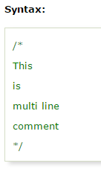
Java Comments
Java Single Line Comment:
The single line comment is used to comment only one line.
Java Multi Line Comment:
The multi line comment is used to comment multiple lines of code.

Slide 71
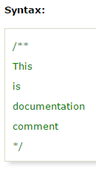
Java Comments
Java Documentation Comment
The documentation comment is used to create documentation API. To create documentation API, you need to use javadoc tool.

Slide 72
Object Oriented Programming

Slide 73
Contents:
OOPs Concepts
Object
Class
Constructor
Static key word
Inheritance
Polymorphism
Access modifiers
Abstraction
Interface

Slide 74
Java OOPs Concepts
Object Oriented Programming is a paradigm that provides many concepts such as inheritance, data binding, polymorphism etc.
Simula is considered as the first object-oriented programming language. The programming paradigm where everything is represented as an object, is known as truly object-oriented programming language.
Smalltalk is considered as the first truly object-oriented programming language.

Slide 75
OOPs (Object Oriented Programming System)
Object means a real word entity such as pen, chair, table etc. Object-Oriented Programming is a methodology or paradigm to design a program using classes and objects. It simplifies the software development and maintenance by providing some concepts:
Object
Class
Inheritance
Polymorphism
Abstraction
Encapsulation

Slide 76
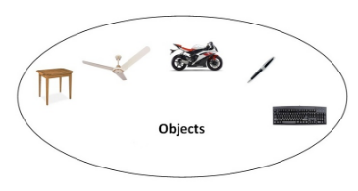
Object
Any entity that has state and behavior is known as an object. For example: chair, pen, table, keyboard, bike etc.
It can be physical and logical.

Slide 77
Object in Java
An object has three characteristics:
state: represents data (value) of an object.
behavior: represents the behavior (functionality) of an object such as deposit, withdraw etc.
identity: Object identity is typically implemented via a unique ID. The value of the ID is not visible to the external user. But, it is used internally by the JVM to identify each object uniquely.
For Example: Pen is an object. Its name is Reynolds, color is white etc. known as its state. It is used to write, so writing is its behavior.

Slide 78
OOPs (Object Oriented Programming System)
Object is an instance of a class. Class is a template or blueprint from which objects are created. So object is the instance(result) of a class.
Object Definitions:
Object is a real world entity.
Object is a run time entity.
Object is an entity which has state and behavior.
Object is an instance of a class.

Slide 79
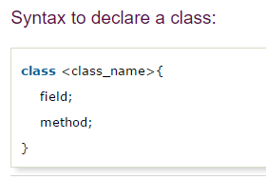
Class in Java
A class is a group of objects which have common properties. It is a template or blueprint from which objects are created. It is a logical entity. It can't be physical.
A class in Java can contain:
fields
methods
constructors
blocks
nested class and interface

Slide 80
Instance variable in Java
A variable which is created inside the class but outside the method, is known as instance variable.
Instance variable doesn't get memory at compile time. It gets memory at run time when object(instance) is created. That is why, it is known as instance variable.

Slide 81
Method in Java
In java, a method is like function i.e. used to expose behavior of an object.
Advantage of Method
Code Reusability
Code Optimization
new keyword in Java
The new keyword is used to allocate memory at run time. All objects get memory in Heap memory area.

Slide 82
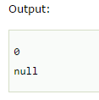
Object and Class Example: main within class
In this example, we have created a Student class that have two data members id and name. We are creating the object of the Student class by new keyword and printing the objects value.
class Student{
int id;//field or data member or instance variable
String name;
public static void main(String args[]){
Student s1=new Student();//creating an object of Student
System.out.println(s1.id);//accessing member through reference variable
System.out.println(s1.name);
}
}

Slide 83

Object and Class Example: main outside class
In real time development, we create classes and use it from another class. It is a better approach than previous one. Let's see a simple example, where we are having main() method in another class.
class Student{
int id;
String name;
}
class TestStudent1{
public static void main(String args[]){
Student s1=new Student();
System.out.println(s1.id);
System.out.println(s1.name);
}
}

Slide 84

Anonymous object
Anonymous simply means nameless. An object which has no reference is known as anonymous object. It can be used at the time of object creation only.
If you have to use an object only once, anonymous object is a good approach. For example:

Slide 85

Example
class Calculation{
void fact(int n){
int fact=1;
for(int i=1;i<=n;i++){
fact=fact*i;
}
System.out.println("factorial is "+fact);
}
public static void main(String args[]){
new Calculation().fact(5);//calling method with anonymous object
}
}

Slide 86

Creating multiple objects by one type only
We can create multiple objects by one type only as we do in case of primitives.

Slide 87

Example:
class Rectangle{
int length;
int width;
void insert(int l,int w){
length=l;
width=w;
}
void calculateArea(){System.out.println(length*width);}
}
class TestRectangle2{
public static void main(String args[]){
Rectangle r1=new Rectangle(),r2=new Rectangle();//creating two objects
r1.insert(11,5);
r2.insert(3,15);
r1.calculateArea();
r2.calculateArea();
}
}

Slide 88

Real World Example: Account
void withdraw(float amt){
if(amount<amt){
System.out.println("Insufficient Balance");
}else{
amount=amount-amt;
System.out.println(amt+" withdrawn");
}
}
void checkBalance(){System.out.println("Balance is: "+amount);}
void display(){System.out.println(acc_no+" "+name+" "+amount);}
}
class TestAccount{
public static void main(String[] args){
Account a1=new Account();
a1.insert(832345,"Ankit",1000);
a1.display();
a1.checkBalance();
a1.deposit(40000);
a1.checkBalance();
a1.withdraw(15000);
a1.checkBalance();
}}
class Account{
int acc_no;
String name;
float amount;
void insert(int a,String n,float amt){
acc_no=a;
name=n;
amount=amt;
}
void deposit(float amt){
amount=amount+amt;
System.out.println(amt+" deposited");
}

Slide 89
Constructor in Java
Constructor in java is a special type of method that is used to initialize the object.
Java constructor is invoked at the time of object creation. It constructs the values i.e. provides data for the object that is why it is known as constructor.
Rules for creating java constructor
There are basically two rules defined for the constructor.
Constructor name must be same as its class name
Constructor must have no explicit return type

Slide 90

Types of java constructors
There are two types of constructors:
Default constructor (no-arg constructor)
Parameterized constructor
Java Default Constructor
A constructor that have no parameter is known as default constructor.

Slide 91


Example of default constructor
class Bike1{
Bike1(){System.out.println("Bike is created");}
public static void main(String args[]){
Bike1 b=new Bike1();
}
}

Slide 92

What is the purpose of default constructor?
Default constructor provides the default values to the object like 0, null etc. depending on the type.
class Student3{
int id;
String name;
void display(){
System.out.println(id+" "+name);
}
public static void main(String args[]){
Student3 s1=new Student3();
Student3 s2=new Student3();
s1.display();
s2.display();
}
}

Slide 93

Java parameterized constructor
A constructor that have parameters is known as parameterized constructor.
Why use parameterized constructor?
Parameterized constructor is used to provide different values to the distinct objects.
class Student4{
int id;
String name;
Student4(int i,String n){
id = i;
name = n;
}
void display(){
System.out.println(id+" "+name);
}
public static void main(String args[]){
Student4 s1 = new Student4(111,"Karan");
Student4 s2 = new Student4(222,"Aryan");
s1.display();
s2.display();
}
}

Slide 94
Difference between constructor and method in java
Java Constructor | Java Method
Constructor is used to initialize the state of an object. | Method is used to expose behaviour of an object.
Constructor must not have return type. | Method must have return type.
Constructor is invoked implicitly. | Method is invoked explicitly.
The java compiler provides a default constructor if you don't have any constructor. | Method is not provided by compiler in any case.
Constructor name must be same as the class name. | Method name may or may not be same as class name.

Slide 95
Java static keyword
The static keyword in java is used for memory management mainly. We can apply java static keyword with variables, methods, blocks and nested class. The static keyword belongs to the class than instance of the class.
The static can be:
variable (also known as class variable)
method (also known as class method)
block

Slide 96
Understanding problem without static variable
Suppose there are 500 students in my college, now all instance data members will get memory each time when object is created.All student have its unique rollno and name so instance data member is good.Here, college refers to the common property of all objects.If we make it static,this field will get memory only once.
Note: Java static property is shared to all objects.
class Student{
int rollno;
String name;
String college="ITS";
}

Slide 97

Example
public static void main(String args[]){
Student8 s1 = new Student8(111,"Karan");
Student8 s2 = new Student8(222,"Aryan");
s1.display();
s2.display();
}
}
//Program of static variable
class Student8{
int rollno;
String name;
static String college ="ITS";
Student8(int r,String n){
rollno = r;
name = n;
}
void display (){
System.out.println(rollno+" "+name+" "+college);
}

Slide 98

Restrictions for static method
There are two main restrictions for the static method. They are:
The static method can not use non static data member or call non-static method directly.
this and super cannot be used in static context.
class A{
int a=40;//non static
public static void main(String args[]){
System.out.println(a);
}
}

Slide 99
Inheritance in Java
Inheritance in java is a mechanism in which one object acquires all the properties and behaviors of parent object.
The idea behind inheritance in java is that you can create new classes that are built upon existing classes. When you inherit from an existing class, you can reuse methods and fields of parent class, and you can add new methods and fields also.
Inheritance represents the IS-A relationship, also known as parent-child relationship.

Slide 100
Why use inheritance in java
For Method Overriding (so runtime polymorphism can be achieved).
For Code Reusability.

Slide 101

Syntax of Java Inheritance
The extends keyword indicates that you are making a new class that derives from an existing class.
In the terminology of Java, a class that is inherited is called a super class. The new class is called a subclass.

Slide 102

Understanding the simple example of inheritance
As displayed in the above figure, Programmer is the subclass and Employee is the superclass.
Relationship between two classes is Programmer IS-A Employee. It means that Programmer is a type of Employee.

Slide 103
Example:
class Employee{
float salary=40000;
}
class Programmer extends Employee{
int bonus=10000;
public static void main(String args[]){
Programmer p=new Programmer();
System.out.println("Programmer salary is:"+p.salary);
System.out.println("Bonus of Programmer is:"+p.bonus);
}
}
In the above example, Programmer object can access the field of own class as well as of Employee class i.e. code reusability.
Programmer salary is:40000.0
Bonus of programmer is:10000

Slide 104

Types of inheritance in java
On the basis of class, there can be three types of inheritance in java: single, multilevel and hierarchical.
In java programming, multiple and hybrid inheritance is supported through interface only. We will learn about interfaces later.

Slide 105

Multiple inheritance:
When a class extends multiple classes i.e. known as multiple inheritance. For Example:

Slide 106
Why multiple inheritance is not supported in java?
To reduce the complexity and simplify the language, multiple inheritance is not supported in java.
Consider a scenario where A, B and C are three classes. The C class inherits A and B classes. If A and B classes have same method and you call it from child class object, there will be ambiguity to call method of A or B class.
Since compile time errors are better than runtime errors, java renders compile time error if you inherit 2 classes. So whether you have same method or different, there will be compile time error now.

Slide 107
Example:
class A{
void msg(){System.out.println("Hello");}
}
class B{
void msg(){System.out.println("Welcome");}
}
class C extends A,B{//suppose if it were
Public Static void main(String args[]){
C obj=new C();
obj.msg();//Now which msg() method would be invoked?
}
}

Slide 108

Encapsulation in Java
Encapsulation in java is a process of wrapping code and data together into a single unit, for example capsule i.e. mixed of several medicines.
We can create a fully encapsulated class in java by making all the data members of the class private. Now we can use setter and getter methods to set and get the data in it.
The Java Bean class is the example of fully encapsulated class.

Slide 109
Advantage of Encapsulation in java
By providing only setter or getter method, you can make the class read-only or write-only.
It provides you the control over the data. Suppose you want to set the value of id i.e. greater than 100 only, you can write the logic inside the setter method.

Slide 110
Simple example of encapsulation in java
Let's see the simple example of encapsulation that has only one field with its setter and getter methods.
class Test{
public static void main(String[] args){
Student s=new Student();
s.setName("vijay");
System.out.println(s.getName());
}
}
public class Student{
private String name;
public String getName(){
return name;
}
public void setName(String name){
this.name=name
}
}
Output: vijay

Slide 111
Access Modifiers in java
There are two types of modifiers in java: access modifiers and non-access modifiers.
The access modifiers in java specifies accessibility (scope) of a data member, method, constructor or class.
There are 4 types of java access modifiers:
private
default
protected
public

Slide 112
Understanding all java access modifiers
Access Modifier | within class | within package | outside package by subclass only | outside package
Private | Y | N | N | N
Default | Y | Y | N | N
Protected | Y | Y | Y | N
Public | Y | Y | Y | Y

Slide 113
Polymorphism in Java
Polymorphism in java is a concept by which we can perform a single action by different ways.
Polymorphism is derived from 2 greek words: poly and morphs. The word "poly" means many and "morphs" means forms. So polymorphism means many forms.
There are two types of polymorphism in java: compile time polymorphism and runtime polymorphism. We can perform polymorphism in java by method overloading and method overriding.
If you overload static method in java, it is the example of compile time polymorphism. Here, we will focus on runtime polymorphism in java.

Slide 114
Runtime Polymorphism in Java
Runtime polymorphism or Dynamic Method Dispatch is a process in which a call to an overridden method is resolved at runtime rather than compile-time.
In this process, an overridden method is called through the reference variable of a superclass. The determination of the method to be called is based on the object being referred to by the reference variable.
Let's first understand the upcasting before Runtime Polymorphism.

Slide 115

Upcasting
When reference variable of Parent class refers to the object of Child class, it is known as upcasting. For example:

Slide 116

Real example of Java Runtime Polymorphism
Consider a scenario, Bank is a class that provides method to get the rate of interest. But, rate of interest may differ according to banks. For example, SBI, ICICI and AXIS banks could provide 8%, 7% and 9% rate of interest.

Slide 117
class Bank{
int getRateOfInterest(){return 0;}
}
class SBI extends Bank{
int getRateOfInterest(){return 8;}
}
class ICICI extends Bank{
int getRateOfInterest(){return 7;}
}
class AXIS extends Bank{
int getRateOfInterest(){return 9;}
}
Output:
SBI Rate of Interest: 8
ICICI Rate of Interest: 7
AXIS Rate of Interest: 9
class Test3{
public static void main(String args[]){
Bank b1=new SBI();
Bank b2=new ICICI();
Bank b3=new AXIS();
System.out.println("SBI Rate of Interest: "+b1.getRateOfInterest());
System.out.println("ICICI Rate of Interest: "+b2.getRateOfInterest());
System.out.println("AXIS Rate of Interest: "+b3.getRateOfInterest());
}
}

Slide 118
Abstract class in Java
A class that is declared with abstract keyword, is known as abstract class in java. It can have abstract and non-abstract methods (method with body).
Before learning java abstract class, let's understand the abstraction in java first.

Slide 119
Abstraction in Java
Abstraction is a process of hiding the implementation details and showing only functionality to the user.
Another way, it shows only important things to the user and hides the internal details for example sending sms, you just type the text and send the message. You don't know the internal processing about the message delivery.
Abstraction lets you focus on what the object does instead of how it does it.
Ways to achieve Abstaction
There are two ways to achieve abstraction in java
Abstract class (0 to 100%)
Interface (100%)

Slide 120
Abstract class in Java
A class that is declared as abstract is known as abstract class.
It needs to be extended and its method implemented. It cannot be instantiated.
Example abstract class:
abstract class A{}

Slide 121
abstract method
A method that is declared as abstract and does not have implementation is known as abstract method.
Example abstract method:
abstract void printStatus();//no body and abstract

Slide 122
Example of abstract class that has abstract method
In this example, Bike the abstract class that contains only one abstract method run. It implementation is provided by the Honda class.
abstract class Bike{
abstract void run();
}
class Honda4 extends Bike{
void run(){System.out.println("running safely..");
}
public static void main(String args[]){
Bike obj = new Honda4();
obj.run();
}
}
running safely..

Slide 123
Example of abstract class in java
abstract class Bank{
abstract int getRateOfInterest();
}
class SBI extends Bank{
int getRateOfInterest(){return 7;}
}
class PNB extends Bank{
int getRateOfInterest(){return 8;}
}
Rate of Interest is: 7 %
Rate of Interest is: 8 %
class TestBank{
public static void main(String args[]){
Bank b;
b=new SBI();
System.out.println("Rate of Interest is: "+b.getRateOfInterest()+" %");
b=new PNB();
System.out.println("Rate of Interest is: "+b.getRateOfInterest()+" %");
}
}

Slide 124
Interface in Java
An interface in java is a blueprint of a class. It has static constants and abstract methods only.
The interface in java is a mechanism to achieve fully abstraction. There can be only abstract methods in the java interface not method body. It is used to achieve fully abstraction and multiple inheritance in Java.
Java Interface also represents IS-A relationship.
It cannot be instantiated just like abstract class.

Slide 125
Why use Java interface?
There are mainly three reasons to use interface. They are given below.
It is used to achieve fully abstraction.
By interface, we can support the functionality of multiple inheritance.
It can be used to achieve loose coupling.
The java compiler adds public and abstract keywords before the interface method and public, static and final keywords before data members.
Interface fields are public, static and final by default, and methods are public and abstract.
Notes:
Loose coupling is an approach to interconnecting the components in a system or network so that those components, also called elements, depend on each other to the least extent practicable. Coupling refers to the degree of direct knowledge that one element has of another.

Slide 126


Slide 127

Understanding relationship between classes and interfaces
As shown in the figure given below, a class extends another class, an interface extends another interface but a class implements an interface.

Slide 128
Simple example of Java interface
In this example, Printable interface have only one method, its implementation is provided in the A class.
interface printable{
void print();
}
class A6 implements printable{
public void print(){System.out.println("Hello");}
public static void main(String args[]){
A6 obj = new A6();
obj.print();
}
}

Slide 129

Multiple inheritance in Java by interface
If a class implements multiple interfaces, or an interface extends multiple interfaces i.e. known as multiple inheritance.

Slide 130
Example
interface Printable{
void print();
}
interface Showable{
void show();
}
class A7 implements Printable,Showable{
public void print(){System.out.println("Hello");}
public void show(){System.out.println("Welcome");}
public static void main(String args[]){
A7 obj = new A7();
obj.print();
obj.show();
}
}

Slide 131
Interface inheritance
A class implements interface but one interface extends another interface .
interface Printable{
void print();
}
interface Showable extends Printable{
void show();
}
class Testinterface2 implements Showable{
public void print(){System.out.println("Hello");}
public void show(){System.out.println("Welcome");}
public static void main(String args[]){
Testinterface2 obj = new Testinterface2();
obj.print();
obj.show();
}
}

Slide 132


